Slide 1
CS2105 Introduction to Computer Networks

Slide 2
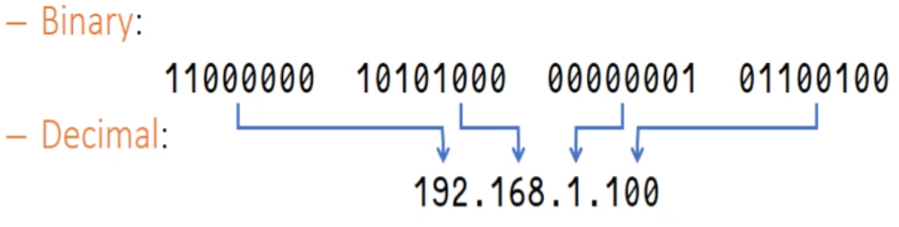
Recap
IP addresses
Bounded to a network interface
Identify hosts/routers
IPv4
32 bit
Represented as binary/decimal
Notes:
Be proficient in converting to and fro binary/decimal!
It is important to realise that a router can have many network interfaces → have multiple IP addresses!

Slide 3
Recap
Hierarchical Addressing – (IP addresses have 2 parts)
Host Identifier
Which host is this in this subnet?
Network(Subnet) prefix
Identifies separate networks(subnets)
All devices in this subnet must have this prefix
What does this tell you about communication within and out of a subnet?
Inter-subnet(out) messages need to pass through a router
Intra-subnet(within) communications doesn’t need router’s full functionality
Notes:
Subnet masks help to identify a network –
If 2 hosts share a common mask, they are in the same network.
You can think of an IP address as your block number concatenated with your unit number (yourBlockAddressYourUnitNumber). The network prefix is your block address, while your unit number identifies you, the host!

Slide 4
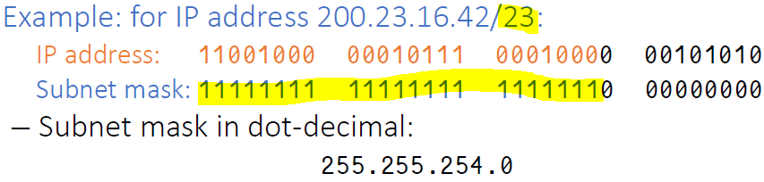
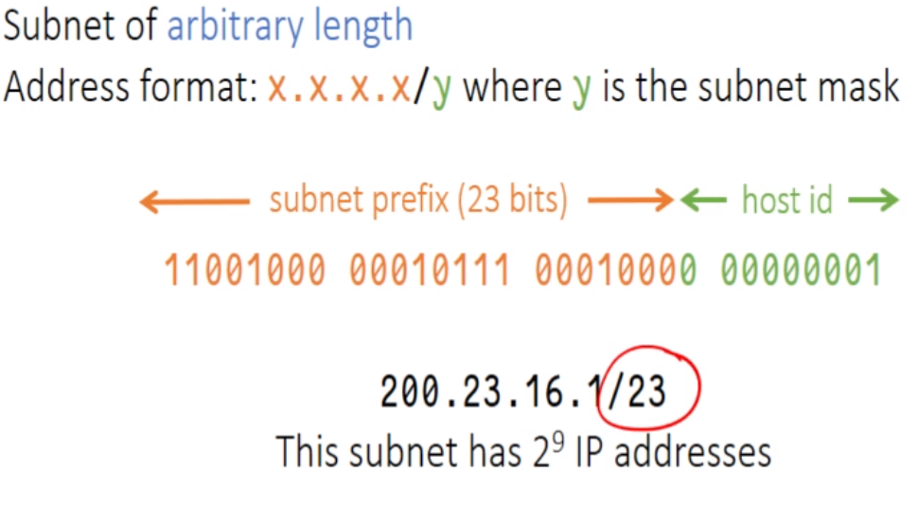
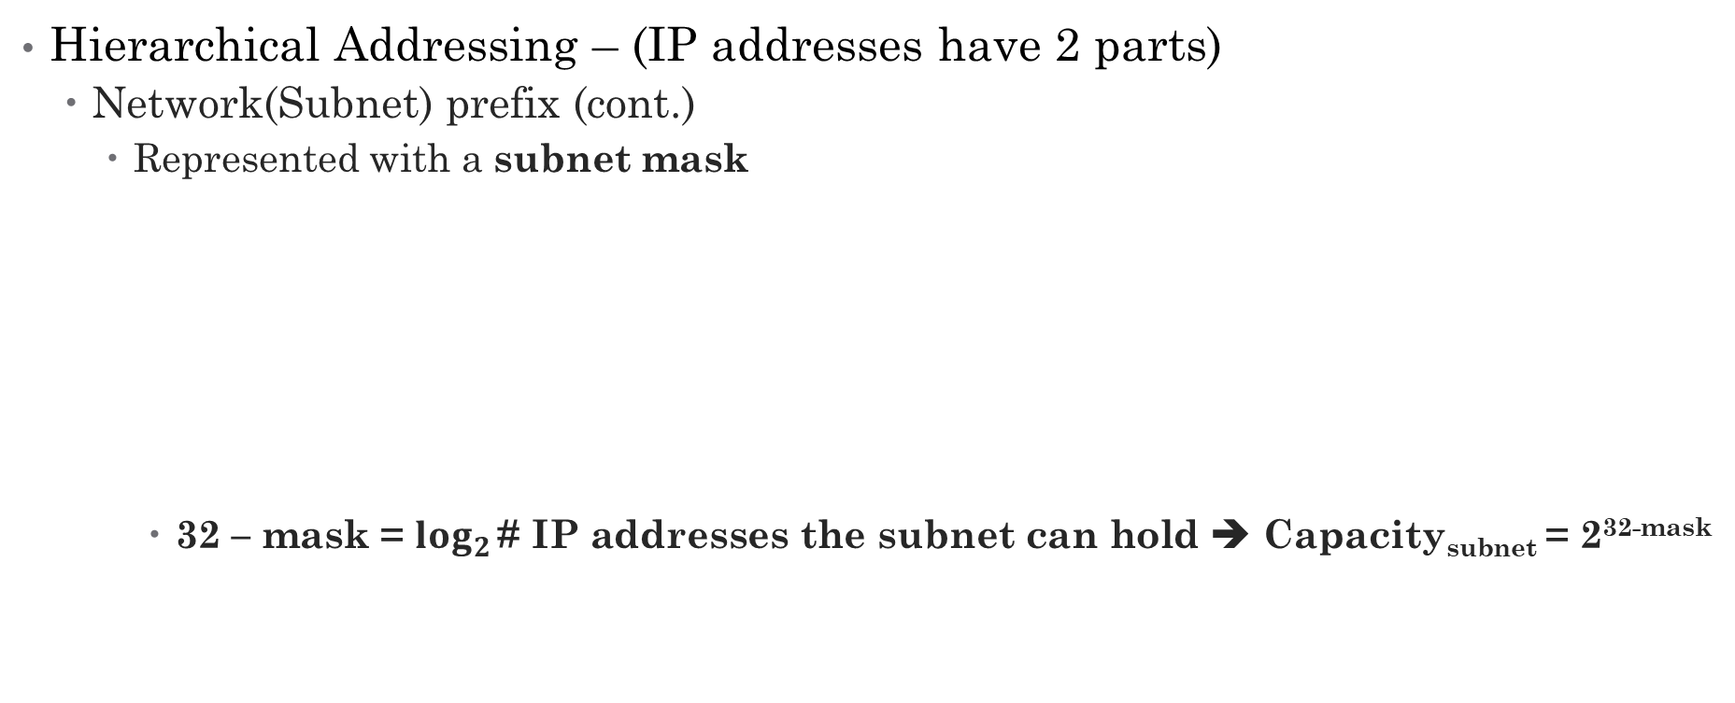
Recap
Hierarchical Addressing – (IP addresses have 2 parts)
Network(Subnet) prefix (cont.)
Represented with a subnet mask
32 – mask = $\log_{2}{\text{\# }\text{IP} \text{addresses} \text{the} \text{subnet} \text{can} \text{hold}}$ ➔ Capacity_{subnet} = 2^{32-mask}
Notes:
Note that subnet masks MUST have a continuous string of 1s from the start
11000000 00000000 00000000 00000000 is a valid mask
10111111 11111111 11111111 11110000 and 11111111 11111111 11111101 00000000 are invalid masks (there is a ‘hole’ in the string of 1s)

Slide 5
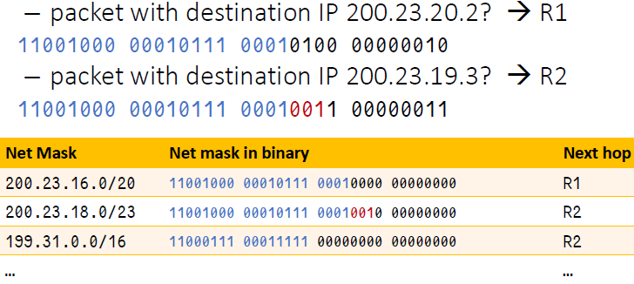
Recap
Longest Prefix Match
Routers forward packets based on how many bits of the packet prefix tallies with the net mask.
This helps to differentiate between subnets!
Notes:
Longest prefix match helps with our identification.
Looking at our example, if our packet has destination IP of the address partially in red, it could have gone to any of the 3 routers in the table!
Longest prefix match deterministically tells us which hop we should go to, in this case it’s the 2nd entry, because it matches the longest prefix of the address.

Slide 6
Recap
Dynamic Host Configuration Protocol (DHCP)
Servers run on UDP port 67, clients on port 68
Identify gateway router, IP address of local DNS, network mask
Allows a host to dynamically (and automatically) obtain an IP address from a DHCP server when it joins a network
IP addresses are “leased” to you when you obtain it from a DHCP
DHCP gives you an IP address for 6 hours; after 6 hours, it checks whether it needs to be renewed (extend lease?)
IP addresses are also reusable
Continuing the analogy, if you leave the network, DHCP can reassign the same IP address to another host entering the network
Good support for mobile users
Able to join different networks easily – all with different IP addresses
Notes:
This slides introduces the high level idea of DHCP, what information it returns (identify gateway router…) and some of its properties.
Things to note:
Idea of leasing
allows for reusability

Slide 7
Recap
Dynamic Host Configuration Protocol (DHCP)
Discover
Hosts broadcasts a discover message
Message is blasted because he does not know the IP addresses (multiple) of the DHCP servers
Offer
DHCP server responds with a broadcasted offer message
Host is not yet offered an IP address, hence DHCP needs to someway to address the host, which is by blasting
When waiting for a response after the offer, the IP address is reserved.
Request
Host broadcasts a request for an IP address here
Multiple DHCP servers can send an offer in response to the discover message
Need to let the other DHCP servers know which IP address he has selected so the other servers can free the reserved IP address.
Acknowledge
DHCP server broadcasts an acknowledgement, allowing host to take on the requested IP address
Again this is broadcasted as the host has not yet assumed the IP address.
Notes:
As with every week, there is a ‘main payload’. This is it.
Things to note:
Familiarise yourself with DORA
Notice that all messages as part of this process is broadcasted – please know the rationale for each step’s need for broadcasting!
Next slide breaks it down

Slide 8
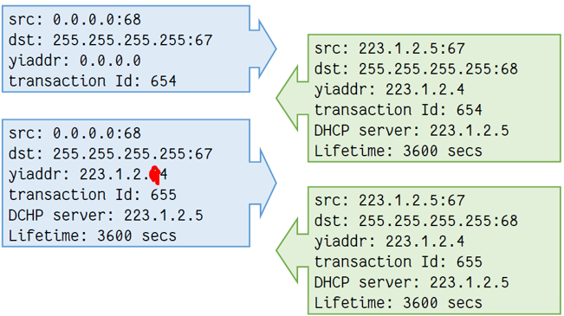
Recap
Notes:
Take note of the fields at each step! TID of D and O is the same but different from R and A (which are the same)
DHCP Discover
Source address with port
Source addresses referring to themselves are defaulted to all 0s.
For eg: 0.0.0.0:68
Destination address with port
As this is a special broadcast discover message, destination address is defaulted to all 1s.
For eg: 255.255.255.255:67
YIADDR (stands for Your Ip ADDress)
Defaulted to all 0s as nothing has been assigned yet!
Transaction ID
So as to identify this entire conversation
Since messages are broadcasted, this helps me filter out messages that are not for me ☺
Randomly generated
There is a chance that TID generated by 1 host may coincide with TID of another host.
This will cause both hosts to pick up the same message and might cause a collision of IP address!
Solution: ARP probe (we will learn ARP in the coming weeks!)
DHCP Offer (note that there can be more than 1 offer!)
Source address with port
Includes its own source address and port specified in the destination field by the initial discover message, in this case, 67.
Destination address with port
As this is again a broadcast message (requester still does not have an IP address assigned to it yet), it is defaulted to all 1s, with the port specified in the source field by the initial discover message, in this case, 68.
note that different requesters will be able to know if the DHCP server is talking to them with the transaction ID
YIADDR
Contains the IP address allocated by the DHCP to the host
Transaction ID
So as to identify that this offer is corresponds to the discover message of the same transaction ID.
DHCP Server
The IP address of the DHCP server (value of this field is similar to YIADDR).
Lifetime
How long the IP address is going to be leased to the host.
DHCP Request (selects 1 offer from all the offers and echoes it in a new transaction)
Responds with the same fields in the offer, with almost the same values.
Only transaction ID is different here.
DHCP ACKnowledgement (confirmation of requested parameters)
Exactly the same as request to signify the successful assignment.

Slide 9
Tutorial Questions

Slide 10
Question 1
[KR, Chapter 4, R13] What is the 32-bit binary equivalent of the IP address 202.3.14.25?
11001010 00000011 00001110 00011001
Notes:
There are some calculator tools out there that allows for this quick math.

Slide 11
Question 2a
Write down the first and last IP addresses of the subnet associated with the following IP address:
244.233.234.12/4
244 = 11110100
First IP address in this subnet = 11110000 00000000 00000000 00000000
= 240.0.0.0
Last IP address in this subnet = 11111111 11111111 11111111 11111111
= 255.255.255.255
Notes:
I pick 244 to be broken down because the subnet mask is 4.
Pick number according to subnet mask i.e. 1-8 means you have to breakdown the 1st number, 9-16 2nd number so on so forth

Slide 12
Question 2b
Write down the first and last IP addresses of the subnet associated with the following IP address:
10.45.123.34/19
123 = 01111011
First IP address in this subnet = 00001010 00101101 01100000 00000000
= 10.45.96.0
Last IP address in this subnet = 00001010 00101101 01111111 11111111
= 10.45.127.255

Slide 13
Question 2 (extra!)
The questions discussed the range of all IP addresses.
What is the range of valid(usable) IP addresses for 192.168.0.0/24?
Valid(usable) = IP addresses that can be assigned.
We know that the very first address is to address the network (network address), in this case 192.168.0.0.
We also know that the very last address is the network broadcast address, ie when the destination address of a packet is 192.168.0.255, the packet is sent to all nodes of that IP network. (Reconcile this with DHCP!)
Hence, valid IP addresses for this example range from 192.168.0.1 to 192.168.0.254, although TYPICALLY, the first assignable IP address is also reserved for the router.
This means that the end hosts are assigned 192.168.0.2 to 192.168.0.254.

Slide 14
Question 3
Combine the following three blocks of IP addresses into a single block:
a) 16.27.24.0/26
b) 16.27.24.64/26
c) 16.27.24.128/25
From a) we get: 00010000 00011011 00011000 00000000
From b) we get: 00010000 00011011 00011000 01000000
From c) we get: 00010000 00011011 00011000 10000000
Expressing the block as a.b.c.d/x, we need to take the most binding constraint, ie maximise x, yet preserve the generality of a.b.c.d.
Observe that the first 24 digits are common ➔ 16.27.24.0/24

Slide 15
Question 4a
[Modified from KR, Chapter 4, P16]
Consider a subnet with network prefix 192.168.56.128/26. Give an example IP address (of form xxx.xxx.xxx.xxx) that belongs to this network.
!!Note that the mask is 26 ➔ 128 = 10000000, the underlined 10 must be preserved!!
Hence, answer is any IP address in the range 192.168.56.128 to 192.168.56.191

Slide 16
Question 4b
Suppose an ISP owns the block of addresses of the form 192.168.56.128/26. Suppose it wants to create four subnets from this block, with each block having the same number of IP addresses. What are the network prefixes (of form a.b.c.d/x) for the four subnets?
Again, we know available addresses = 192.168.56.128 - 192.168.56.191
What the question is really asking: how can I divide my subnets equally, and identify each of them uniquely?
Rephrasing, how can I uniquely identify the 4 subnets which span the range of 192.168.56.128 to 192.168.56.191?

Slide 17
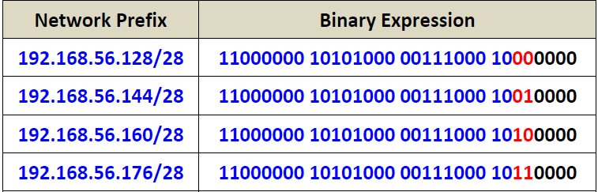
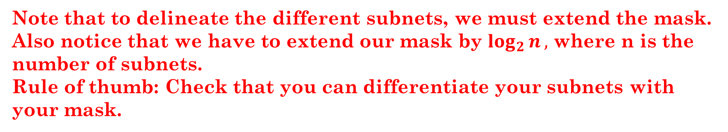
Question 4b
How can I uniquely identify the 4 subnets which span the range of 192.168.56.128 to 192.168.56.191?
192.168.56.128 to 192.168.56.191 ➔ 64 IP addresses ➔ subnet of size 16
The start of these subnets should hence be 192.168.56.128, 192.168.56.144, 192.168.56.160 and 192.168.56.176.
Note that to delineate the different subnets, we must extend the mask.
Also notice that we have to extend our mask by $\log_{2}{n},$ where n is the number of subnets.
Rule of thumb: Check that you can differentiate your subnets with your mask.

Slide 18
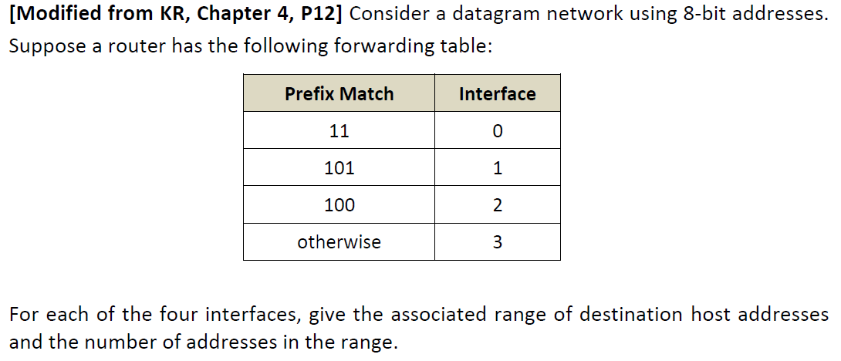
Question 5

Slide 19
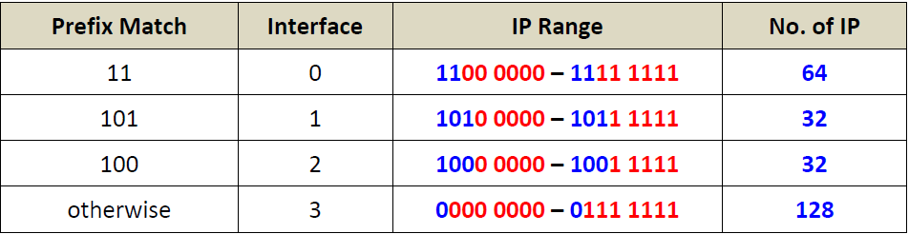
Question 5
What the question is asking: How do I “span” all the possible IP addresses (0000 0000 to 1111 1111) WITHOUT allowing datagrams to face a conflict as to which interface to go to?
By longest prefix match, we know that “11” has to “take care” of 1100 0000 to 1111 1111.
Similarly, “101” has to “take care” of 1010 0000 of 1011 1111,
“100” has to “take care” of 1000 0000 of 1001 1111,
and otherwise has to “take care” of the rest of the IP not yet covered.

Slide 20
Question 6
What is private IP address? Does IVLE use private or public IP? When your laptop is connected to NUS network, does it receive a private or public IP?
The Internet Assigned Numbers Authority (IANA) has reserved the following three blocks of IP address space for private networks:
10.0.0.0 - 10.255.255.255 (10/8 prefix)
172.16.0.0 - 172.31.255.255 (172.16/12 prefix)
192.168.0.0 - 192.168.255.255 (192.168/16 prefix)
An enterprise that decides to use private IP addresses can do so without any coordination with IANA or an Internet registry. The address space can thus be used by many enterprises.
However, private IP addresses cannot have IP connectivity to any host outside of the enterprise. NAT or application layer gateways are needed to map private to public address and vice versa when traffic goes in and out private network.
Private IP is initially designed for experimentation purpose, but now used as a way to alleviate IPv4 address exhaustion. Its use is very common today.
IVLE use public IP address (137.132.10.10). Students may use ping command to check it. Laptops of students are assigned private IP addresses (e.g. 172.26.184.76).
Notes:
We will dive into the concepts of NAT next week!

Slide 21
Summary
IP addresses
Hierarchical Addressing
Subnet Masks
Longest Prefix Match
DHCP

Slide 22
Extra Questions
Given a subnet of 222.22.22.0/27, which of the following addresses belong to the same subnet? (Pick all that apply)
222.22.22.22
222.22.22.23
222.22.22.30
222.22.22.31
222.22.22.32

Slide 23
Extra Questions
An enterprise has been given the following IP address block: 137.132.64.0/18.
Which of the following subnet and host combinations are possible given the above address block? (Pick all that apply)
6 subnets with 7000 hosts each
10 subnets with 1020 hosts each
20 subnets with 800 hosts each
30 subnets with 500 hosts each
200 subnets with 200 hosts each

Slide 24
Thank you!
Answers:
Q1. All but E,
Q2. B and D
Notes:
Answers:
Q1. All but E,
Q2. B and D

